Slide 1
“Do you dare to step into the place between?”

Slide 2
First thoughts…looking at the cover
What can we deduce about Leon?
How old is he? What is he holding? What is he wearing? Where is he?
Where might the story be set?
What clues are there that it is about magic?
How does the page feel to the touch? What effect does this have?
What does the tag line say? How does this give us clues?
Complete the prediction sheet – keep it secret! We’re going to seal it and keep it until the end!

Slide 3

Look closely at the picture:
Where are the children? How can you tell?
Find at least three clues about the weather and time of year.
Who is most interested? How do you know?

Slide 4
Meeting the characters…
1. Draw four stick characters.
2. Label them with the names of the four children.
3. Find a way to show how you think they are related – how do you know?
4. Put a star next to the two who believe in magic and a black circle next to the two who don’t.
5. Number them 1-4 from the youngest up to the oldest – how do you know?
Word hunt!
Find and copy two verbs that show they have to be quiet.
Find and copy an adverb that shows the crowd really want to get started.

Slide 5
1. Use the picture to work out what the word ‘braid’ means. I
2. What does ‘ripple’ mean? How does it help us to picture how it moves? V/E
3. Why do you think the author chose the colour gold? E
4. How does this page build the tension still further? E
Choose three words to describe how the characters are feeling. V
Use your knowledge of magic shows and the front cover to predict something that might now happen… P
Use the clue on the next slide to predict what the first act might be… P

Slide 6
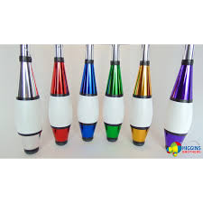

Slide 7
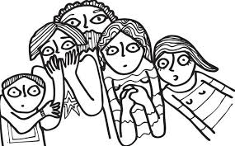
Follow carefully and look at how the words are read differently when the font changes and the ellipsis is included…
What is the contrast between the size of the first and last lines? E
What effect does this have on how we read it?
How does the ellipsis add suspense?
2. How do the jugglers enter the stage? Why is this more dramatic than just walking on? V
3. Identify as many sounds as you can from this page. R/V
Choose three adjectives to describe the audience’s thoughts after that act. S

Slide 8
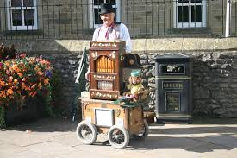
<a href="https://www.tripadvisor.co.uk/LocationPhotos-g209968-Bakewell_Peak_District_National_Park_England.html#194696156"><img alt="" src="https://media-cdn.tripadvisor.com/media/photo-s/0b/9a/d3/dc/bakewell-s-official-organ.jpg"/></a><br/>This photo of Bakewell is courtesy of Tripadvisor
https://www.youtube.com/watch?v=DXo52LHFtBs

Slide 9
1. Summarizing challenge! Can you summarize what happens in these pages in less than 15 words? S
Can you identify at least three ways that the author creates a slightly spooky atmosphere on these pages? E
How does the music from the barrel organ seem to be alive? I
Can you identify all the verbs used to describe the mechanical toys? V
Why does Leon edge forward?
What does this tell us about how he feels?
How does the picture of him back this up? I
6. Explain how the ellipsis adds tension…

Slide 10
Read this page aloud in pairs – use clues about the font size and punctuation to make your expression fantastic.
Why do you think the author chose purple smoke? E
Could Leon really “smell the magic”? What could the author mean here? I/E

Slide 11
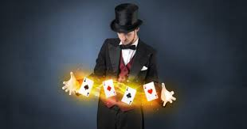
1. Read the page together – try to match any of the details from the picture with each of the tricks that are mentioned. R
2. Put the four tricks into the order in which you think you’d be most impressed – why? E

Slide 12
Pause and consider…
Why do you think Little Mo gasps? I
2. Why do you think Leon “knew it had to be him”? I
3. How do you think the actual box cut into the page helps us to picture Leon’s adventure? E
4. Why do you think the illustrator had the magician staring through the box? E

Slide 13
What was inside the box?
Who does he meet?
Where does Leon find out he is?
What is the ‘place between’?
How would you describe ‘pantaloons trousers’?
How would you describe Leon’s feelings right now?
7. Based on what he’s been told, what objects would you predict Leon might see on the next page?

Slide 14
What does Leon find and why is it there? R
How do we know it is lonely? I
What do you think Leon will do about it? P

Slide 15
Looking closely…
1. Find and copy two adjectives that show us how Leon is feeling.
2. Find and copy two words that help us feel as though the atmosphere is a bit like space.
3. Look again at the ‘flying back’ page – what tiny detail can you spot that helps to explain the front cover?
4. What do you think the magician is thinking?

Slide 16
What is ‘sharp tap’? Try to create one on the desk.
What does ‘majestic’ mean?
Why do you think Tom and Little Mo clap the loudest of all?
What has happened to Tom’s opinion?
Who isn’t mentioned? Why could this be?

Slide 17
“DID YOU REALLY DISAPPEAR?” asked Pete as they shuffled out into the night.
“Of course he did,” said Tom. “See, this is a magic rabbit.”
He stroked her long, soft ears.
“BUT WHERE DID YOU GO?” asked Little Mo.

Slide 18
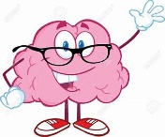
Sequencing challenge:
Below is a list of all the tricks included in the show. Can you put them into the right order and complete the director’s notes?
Barrel organ monkey
Magic box
Paper flowers from the magician’s sleeves
Magic carpet ride
Mechanical toys
Return of the audience member
Silk scarves changing colour
Audience member visits the place between
Water turns into the night air
Juggling
Sparks from Abdul Kazam’s fingertips
Director’s notes - acts in order of appearance…
What happens that the director couldn’t have known would happen?

